Slide 1
Monday 9th July LO: to be able to how the Peasants felt in 1381.
Literacy starter:
How many words can you make using only the letters in the word PEASANT?
Core = 0 – 5 words
Extension = 6 – 10 words
Killer = 11+ words

Slide 2
Learning Outcomes
Core | Extension | Killer
to be able to give reasons why the peasants were angry with the king in 1381 | to be able to explain the different problems in England in 1381 | to be able to say which was the most important point which upset the peasants in 1381

Slide 3
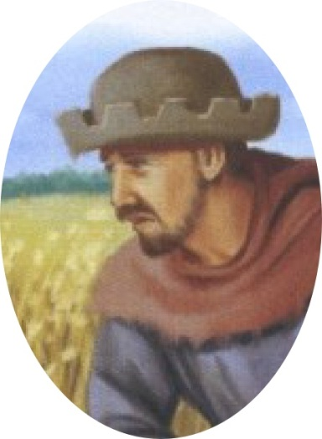
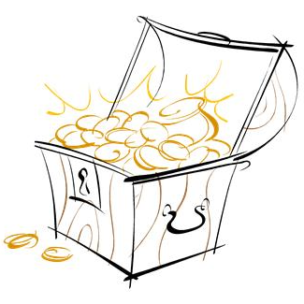
Life after the black death
Remember the Black Death 30 years ago? After all those deaths the lords didn’t have enough people to farm the fields. People hoped this would lead to higher wages or getting their freedom.
But the lords were frightened. They didn’t want to pay people higher wages – or set them free.
So the King made a law saying
“Villeins could not be freed”
“Freemen had to work for the same wages as before the Black Death”
In short, people’s hopes of a better life disappeared.

Slide 4
Peasants after the Black Death would be feeling...
Your teacher will give each table a mini whiteboard.
Take it in turns to pass the board around and write how the peasants were feeling.
The table who makes the longest list of valid feelings, wins.
You have 1 minute.

Slide 5
Peasants after the Black Death would be feeling...
- Let’s share your answers.

Slide 6
Peasants after the Black Death would be feeling...
- Hangman - synonyms
You are going to play hangman, girls versus boys.
If your team guesses a letter correctly, you go again. Your team keeps on guessing letters until either they complete the word or they get a letter wrong.
If you get a letter wrong, the turn passes to the other side.
The first team to win 2 games, wins overall.

Slide 7
After the black death: Mini plenary
Question:
If you were a peasant in 1381 why would you be unhappy?
Copy and complete the following sentences:
“If I was peasant in 1381, I would feel ...(feeling)..because …(reason).
“Also, I would be ..(feeling)..…
because (reason)”

Slide 8
Learning Outcomes
Core | Extension | Killer
to be able to give reasons why the peasants were angry with the king in 1381 | to be able to explain the different problems in England in 1381 | to be able to say which was the most important point which upset the peasants in 1381

Slide 9
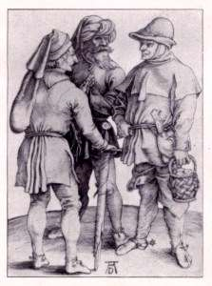
Why are these problems upsetting the peasants?
The French are attacking towns only 20 miles from where we live.
And the government has collected 5 taxes in 4 years. We used to pay tax once every 3 or 4 years
The latest tax is another POLL TAX. Everyone pays the same – lords and villagers.
And it’s 3 times higher than the last one.
We still have to do two days unpaid labour work for the lord.
Things were a bit better after the Black Death but now wages are really low again.

Slide 10
Why are these problems upsetting the peasants?
As a table, agree and list the top 3 Peasants’ problems following the Black Death. One person should write the answers on the mini whiteboard and be prepared to share them with the class.
1.
2.
3.

Slide 11
Mini plenary: Why were the peasants so unhappy in 1381? - sheet
PROBLEM | Why it upset the peasants | What could the king do about it?
The French are attacking towns only 20 miles from where we live.
And the government has collected 5 taxes in 4 years. We used to pay tax once every 3 or 4 years
The latest tax is another POLL TAX. Everyone pays the same – lords and villagers. And it’s 3 times higher than the last one.
Things were a bit better after the Black Death but now wages are really low again.
We still have to do two days unpaid labour work for the lord.

Slide 12
Learning Outcomes
Core | Extension | Killer
to be able to give reasons why the peasants were angry with the king in 1381 | to be able to explain the different problems in England in 1381 | to be able to say which was the most important point which upset the peasants in 1381

Slide 13
COMPLAINTS CONTINUUM
Which were the most serious complaints?
Which were the least serious complaints?
In pairs agree to an order and then both of you organise them onto a continuum on a clean page of your exercise book
Most serious complaint
Least serious complaint

Slide 14
COMPLAINTS CONTINUUM
Which were the most serious complaints?
Which were the least serious complaints?
In pairs agree to an order and then both of you organise them onto a continuum on a clean page of your exercise book
Extension – write a short paragraph, explaining your order (level 5-6)
Most serious complaint
French attack
Same tax for all
Higher taxes
More frequent taxes
2 days free work
Low wages again
Least serious complaint

Slide 15
Learning Outcomes
Core | Extension | Killer
to be able to give reasons why the peasants were angry with the king in 1381 | to be able to explain the different problems in England in 1381 | to be able to say which was the most important point which upset the peasants in 1381

Slide 16
Who’s to blame for the problems?
This is not the fault of our King, Richard II. He’s only 14... it’s the fault of those evil swine who advise him!
Down with
Simon of Sudbury
who made the law!
(He’s Lord Chancellor and Archbishop of Canterbury)
You’re right!
Shame on that foul pig John of Gaunt who persuaded the king to agree
A curse on Robert of Hales who looks after England’s treasure – our money!

Slide 17
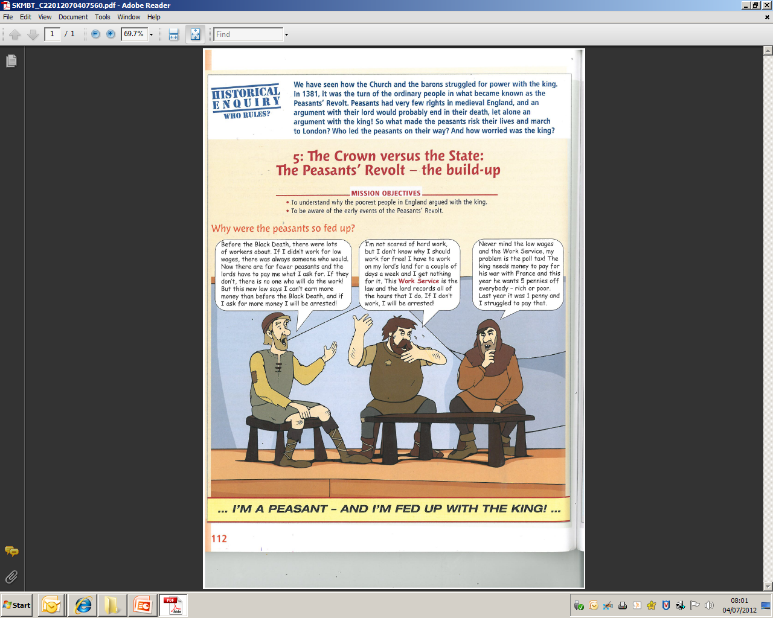
PLENARY
It’s no good doing nothing about all these problems.
Question: If you were a peasant in 1381 how would you try to solve them?
“If I was a peasant in 1381 firstly I would ….. The effect of this would be....
Secondly I would... because...”

Slide 18
I’m a peasant and I’m upset with the king because …(Extra)
ROLE PLAY
In threes develop a role play as three peasants. Each of you should explain why you are upset with the king.

